Slide 1
Forces

Slide 2
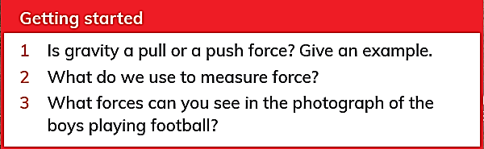
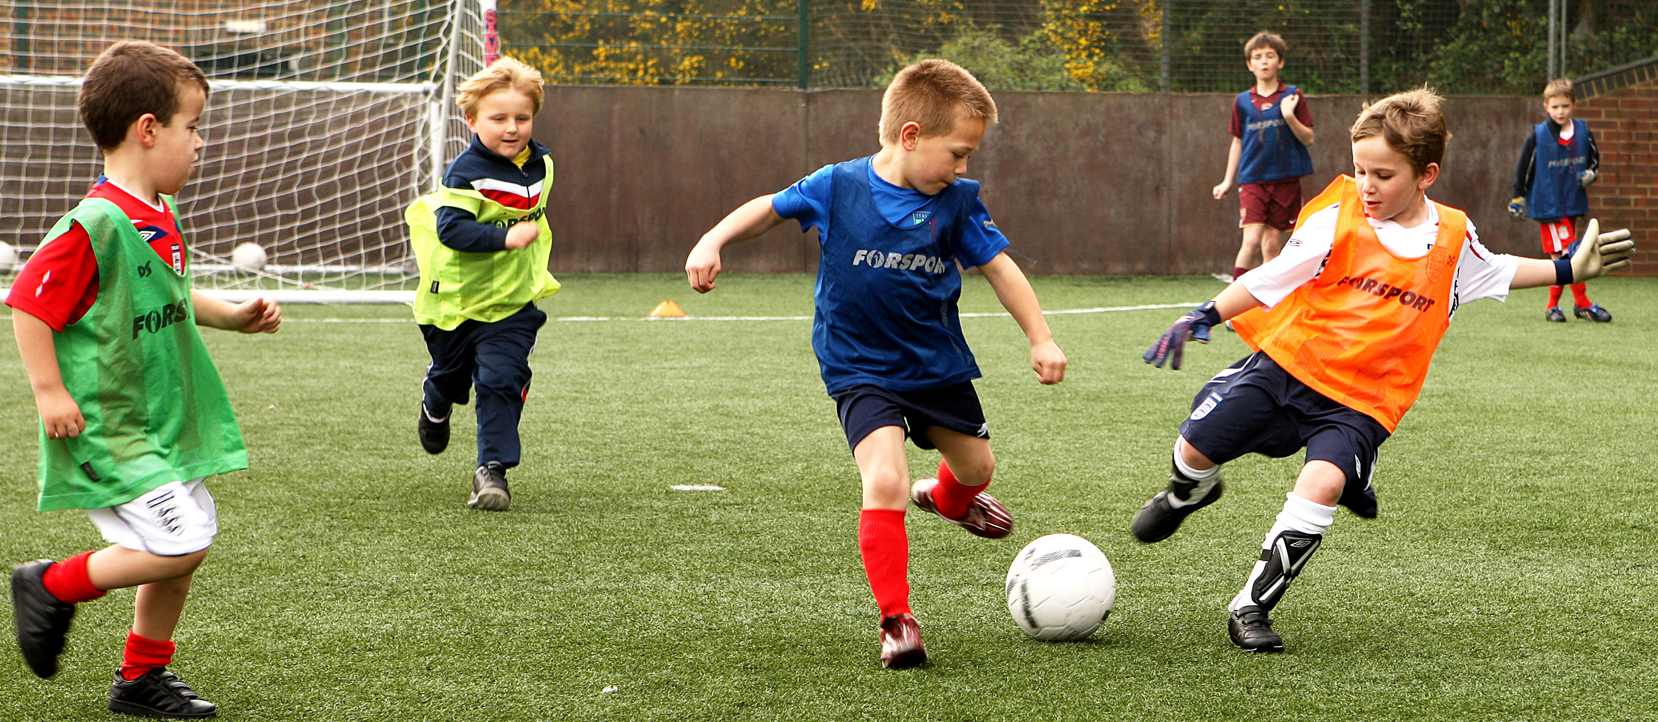
From this picture you can
find that force used to :
1- speed up the object movement.
2- slow down the object movement
3- change the direction of the moving object.
4- start and stop movement of objects.

Slide 3
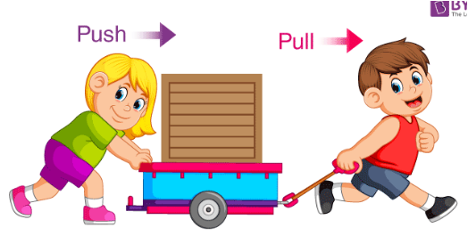
Applied Force:
It is a force applied to an object by a person such as pushing and pulling

Slide 4
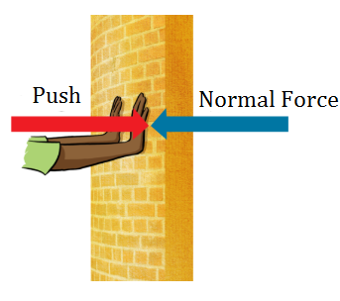
Normal Force:
It acts when objects are touching.
Example:
The force pushing back the wall if you are
Pushing it.

Slide 5
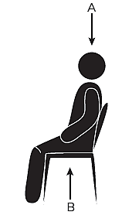
Force Diagrams.
Forces act in pairs.
Each force is shown as an arrow.
We can show the direction of forces on a force diagram by the direction of the arrow.
The stronger the force, the longer the arrow.
If the two forces are equal so the arrows are
the same size.

Slide 6
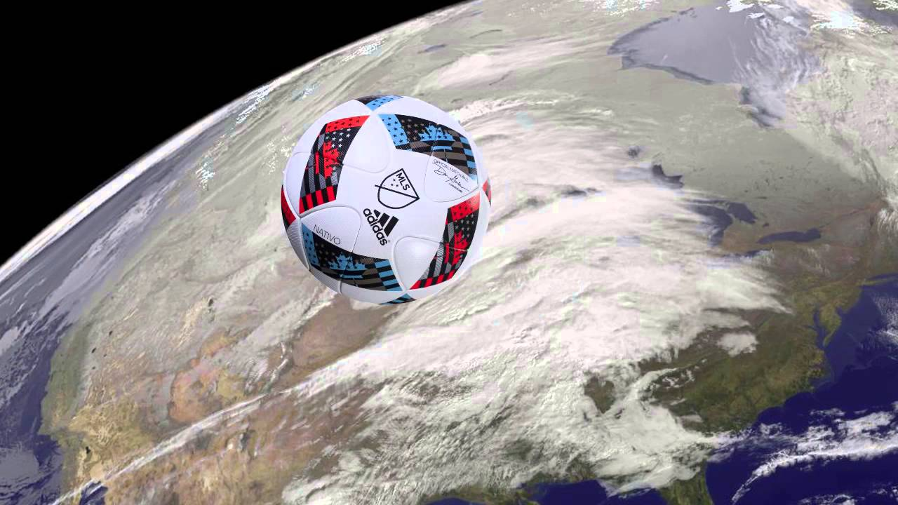
Gravity
Gravity is very important to our everyday lives. Without gravity we would fly off the Earth! We would all have to be tied down all the time. If you kicked a ball, it would fly off forever.

Slide 7
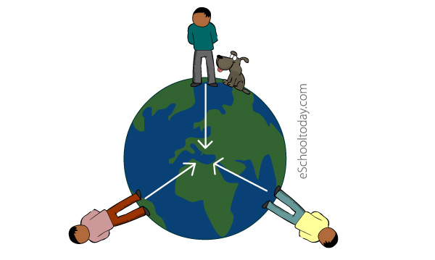
Gravity works on both objects at rest and objects that are moving.
Gravity is the force which attracts or pulls all objects towards the Earth’s center.

Slide 8
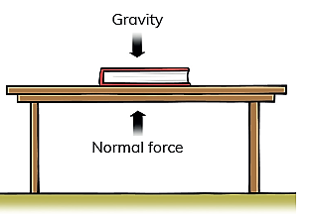
If you put a book on a table the book is at rest. Are there any forces acting on the book?
The book will make or exert a downward force on the table.
This force is gravity (weight) pulling the book downwards, This force is measured in Newton (N). But the book does not fall, so something must be pushing it up. This is called the normal force - reaction force- support force.

Slide 9
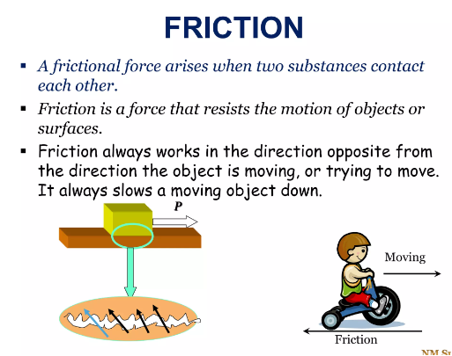
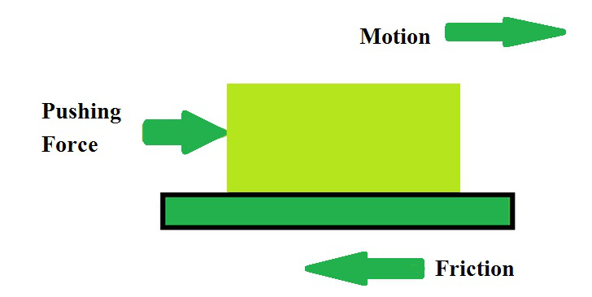
Applied force and friction

Slide 10
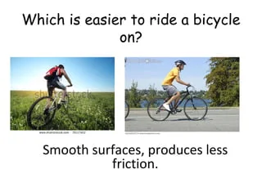

Slide 11
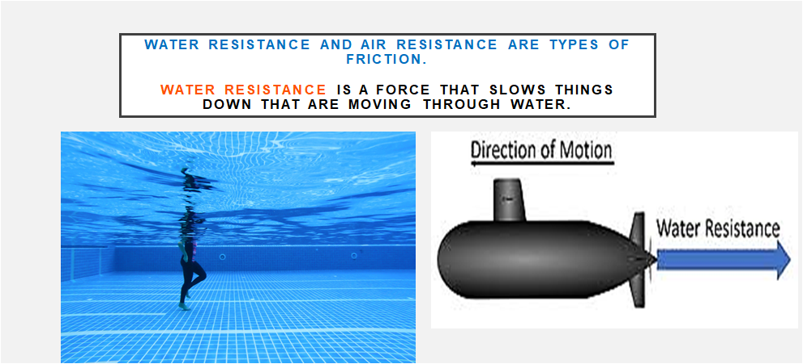

Slide 12
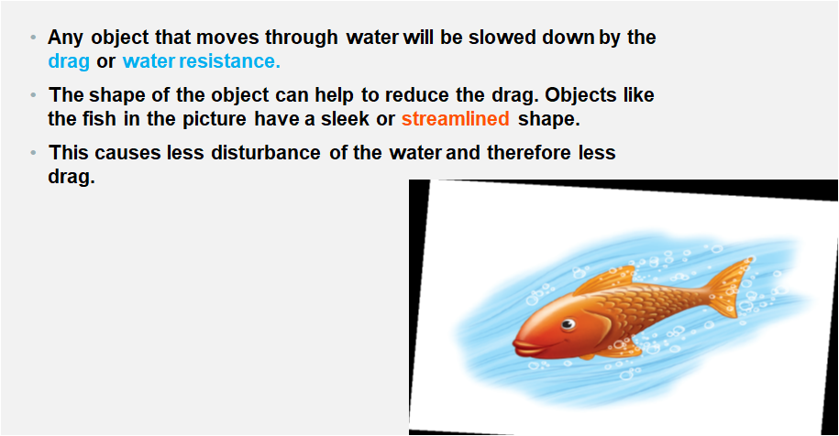

Slide 13
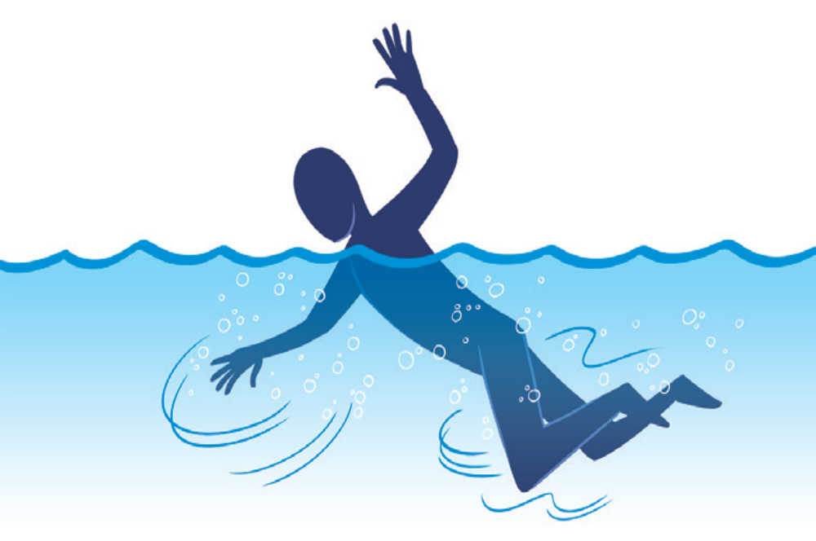
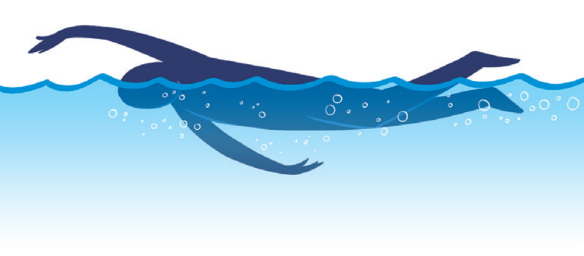
Swimmers try to copy the streamlined shape of fish.

Slide 14
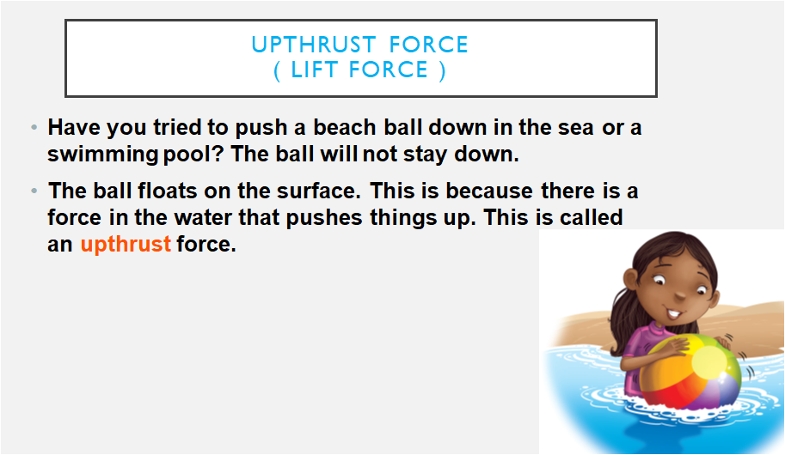

Slide 15
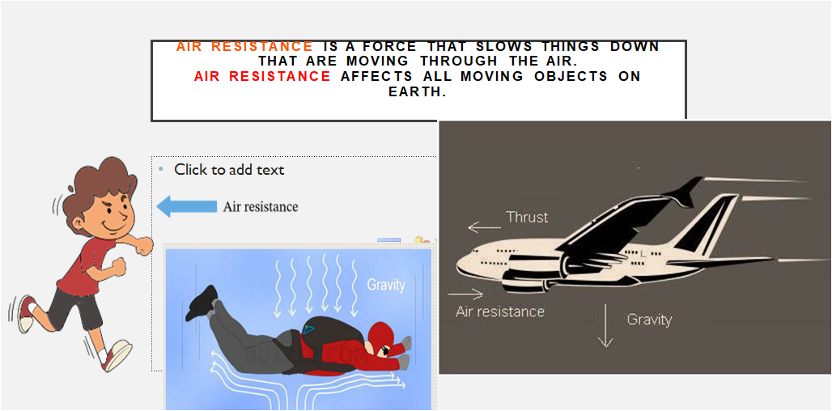

Slide 16
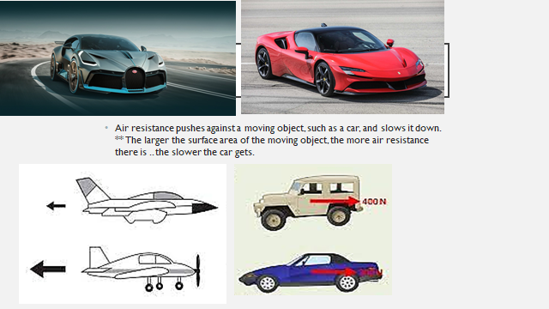

Slide 17
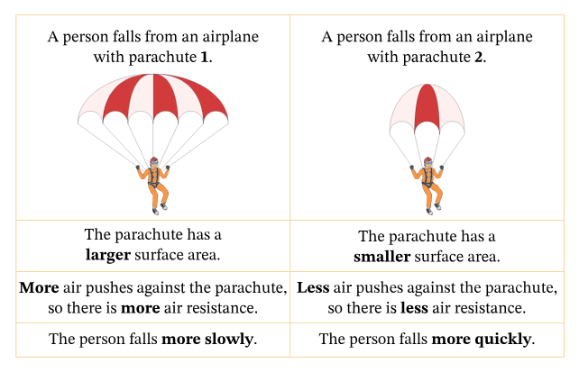

Slide 18
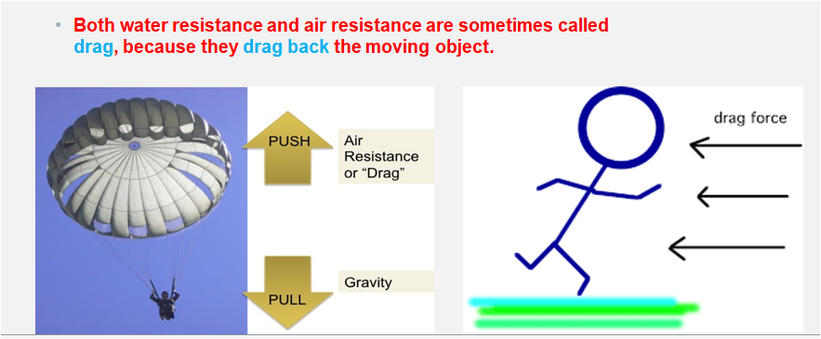

Slide 19
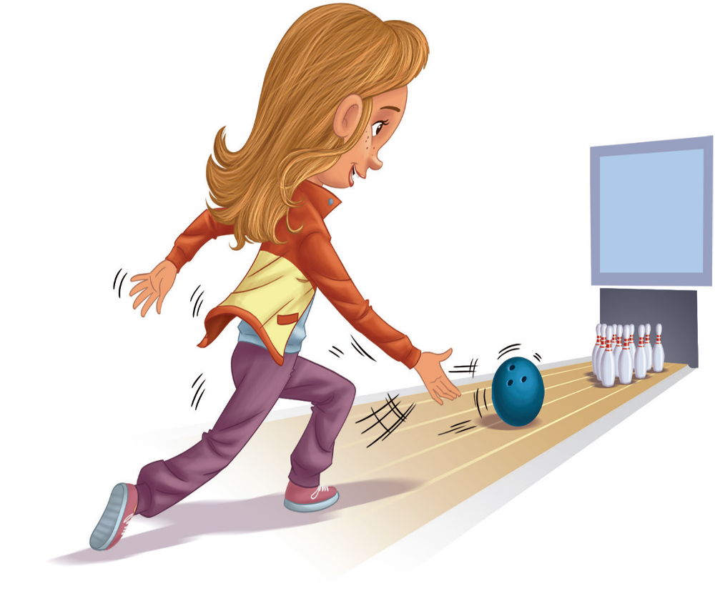
Third Topic :
Many (MULTIPLE) forces act together
All objects are affected by several different forces or multiple forces at once.
Look at this example of Sofia rolling a ball.
There are multiple forces acting on the ball:
• Applied force, as Sofia pushes the ball.
• Gravity pulls the ball down towards the Earth.
• Air resistance slows the ball down once it is moving.
• Friction with the floor slows the ball down once it is moving.

Slide 20
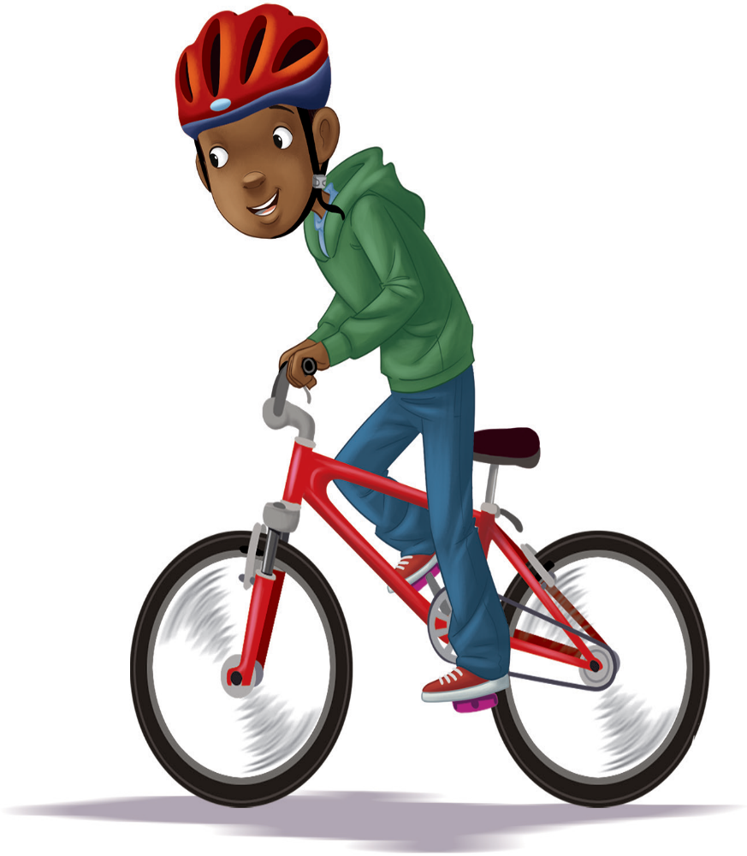
Which forces are acting when you ride a bicycle?
Gravity is pulling Marcus and the bicycle towards
the centre of the Earth.
Friction between the tyres and the road is pulling him back.
Air resistance is also pulling him back.
To overcome the air resistance and friction,
Marcus must push on the pedals to push the
bicycle forwards.
This is called thrust or push. Thrust is an applied force.

Slide 21
Important notes :
Upthrust force is called (Lift)
Air resistance is called (Drag)
Push force is called (Thrust)
Water resistance is a friction force that is opposite in direction to the moving object, while the upthrust force is a force in water that pushes objects up.
Water resistance
The moving object
Upthrust force

Slide 22
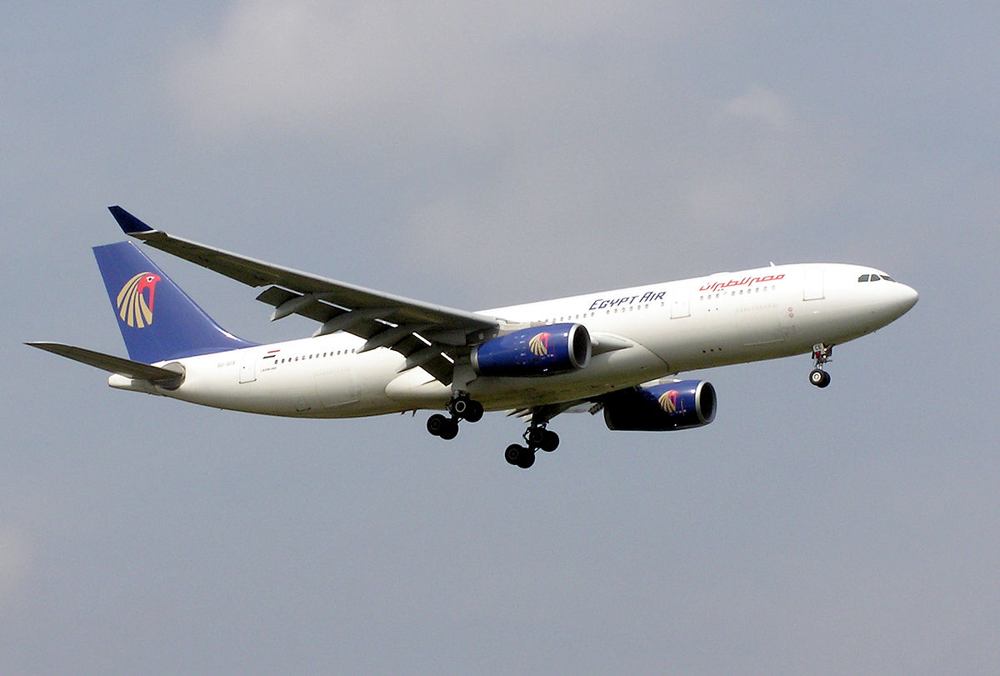
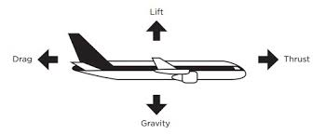
Forces acting on aeroplanes
Air resistance and gravity are the two forces acting on aeroplanes while trying to fly.
To overcome these forces we have to create our own forces of thrust and lifting up .. The engine and wings help with that.

Slide 23
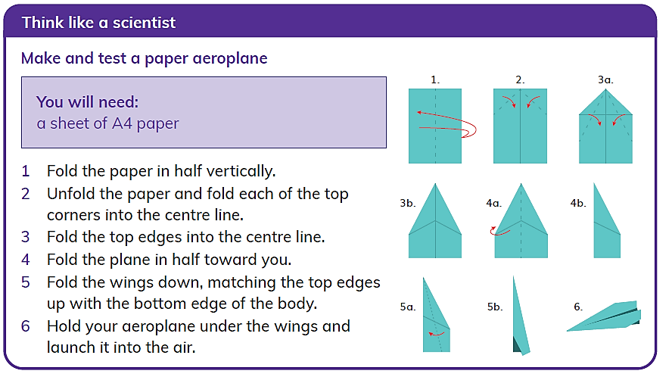

Slide 24
Thank you

